Slide 1
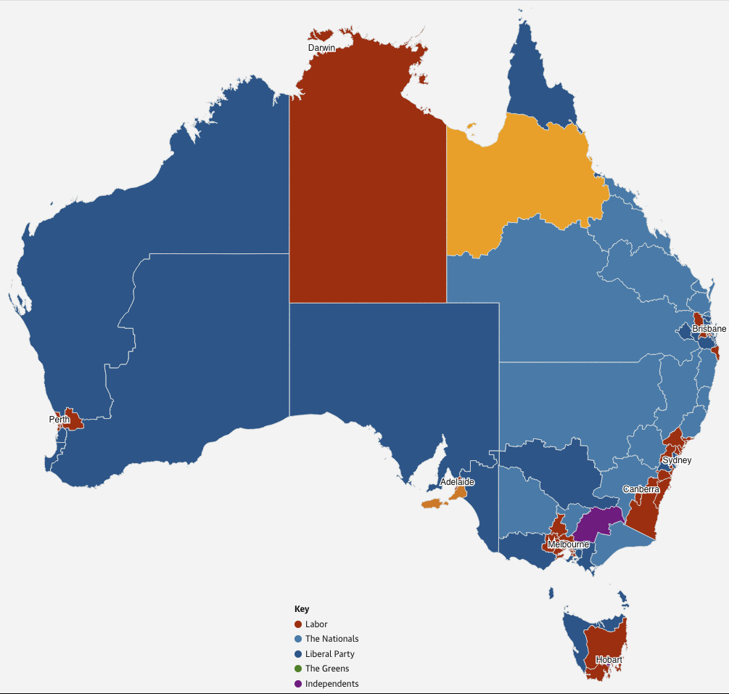

Slide 2
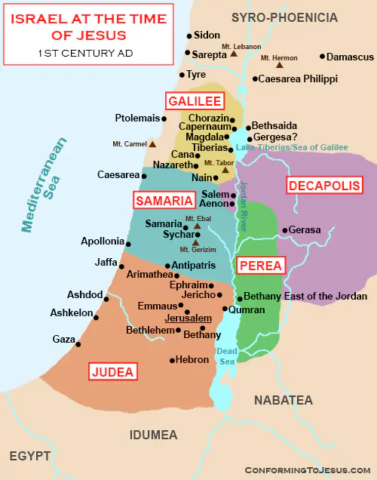

Slide 3
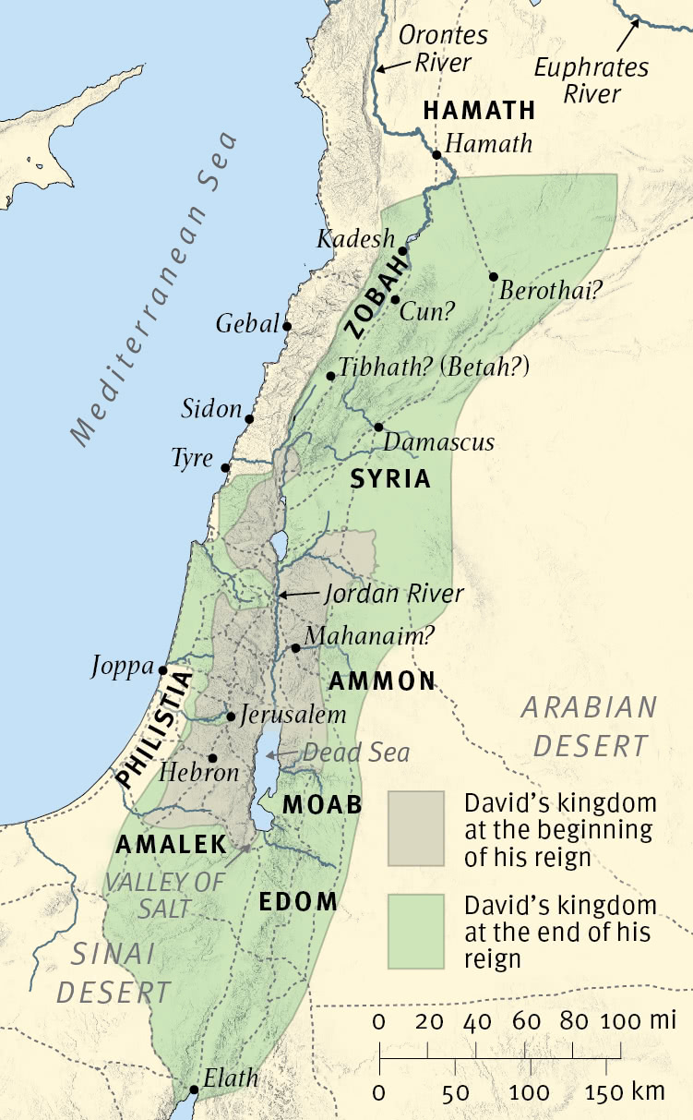

Slide 4
1 Kings 11: (ESV)
³ He had 700 wives, who were princesses, and 300 concubines. And his wives turned away his heart. ⁴ For when Solomon was old his wives turned away his heart after other gods, and his heart was not wholly true to the Lord his God, as was the heart of David his father. ⁵ For Solomon went after Ashtoreth the goddess of the Sidonians, and after Milcom the abomination of the Ammonites. ⁶ So Solomon did what was evil in the sight of the Lord and did not wholly follow the Lord, as David his father had done. ⁷ Then Solomon built a high place for Chemosh the abomination of Moab, and for Molech the abomination of the Ammonites, on the mountain east of Jerusalem. ⁸ And so he did for all his foreign wives, who made offerings and sacrificed to their gods.
⁹ And the Lord was angry with Solomon, because his heart had turned away from the Lord, the God of Israel, who had appeared to him twice ¹⁰ and had commanded him concerning this thing, that he should not go after other gods. But he did not keep what the Lord commanded. ¹¹ Therefore the Lord said to Solomon, “Since this has been your practice and you have not kept my covenant and my statutes that I have commanded you, I will surely tear the kingdom from you and will give it to your servant. ¹² Yet for the sake of David your father I will not do it in your days, but I will tear it out of the hand of your son. ¹³ However, I will not tear away all the kingdom, but I will give one tribe to your son, for the sake of David my servant and for the sake of Jerusalem that I have chosen.”

Slide 5
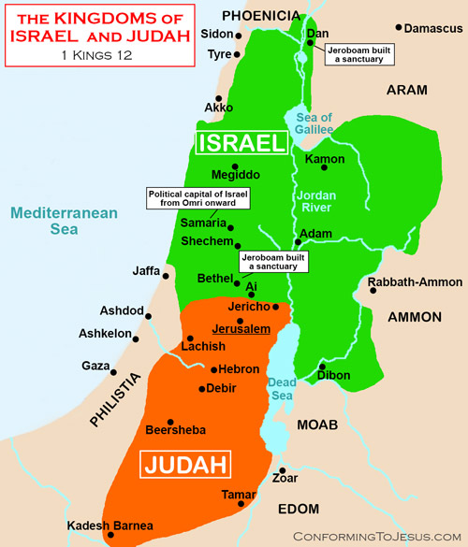

Slide 6
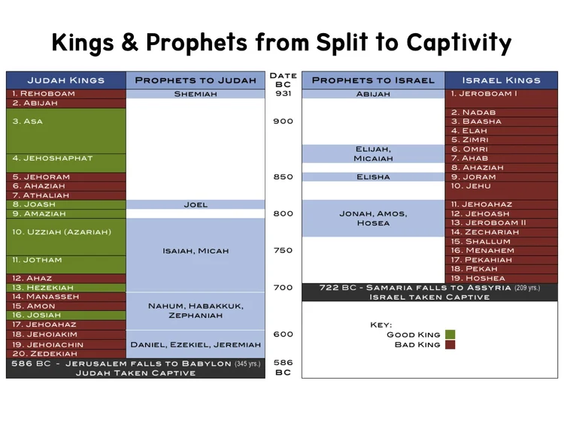

Slide 7
Judah restored to their land (Southern Kingdom). Now determined to remain loyal to God.
Nehemiah 2: (ESV)
³ I said to the king, “Let the king live forever! Why should not my face be sad, when the city, the place of my fathers’ graves, lies in ruins, and its gates have been destroyed by fire?” ⁴ Then the king said to me, “What are you requesting?” So I prayed to the God of heaven. ⁵ And I said to the king, “If it pleases the king, and if your servant has found favour in your sight, that you send me to Judah, to the city of my fathers’ graves, that I may rebuild it.” ⁶ And the king said to me (the queen sitting beside him), “How long will you be gone, and when will you return?” So it pleased the king to send me when I had given him a time.

Slide 8
Judah restored to their land (Southern Kingdom). Now determined to remain loyal to God.
Israel in the North:
Most people taken away into captivity by Assyria;
Assyria re-populates the land with other peoples of other gods.
Introduce worship of YHWH along with their continuing idolatry.
2 Kings 17 (ESV)
²⁴ And the king of Assyria brought people from Babylon, Cuthah, Avva, Hamath, and Sepharvaim, and placed them in the cities of Samaria instead of the people of Israel. And they took possession of Samaria and lived in its cities. ²⁵ And at the beginning of their dwelling there, they did not fear the Lord. Therefore the Lord sent lions among them, which killed some of them. ²⁶ So the king of Assyria was told, “The nations that you have carried away and placed in the cities of Samaria do not know the law of the god of the land. Therefore he has sent lions among them, and behold, they are killing them, because they do not know the law of the god of the land.”
²⁷ Then the king of Assyria commanded, “Send there one of the priests whom you carried away from there, and let him go and dwell there and teach them the law of the god of the land.” ²⁸ So one of the priests whom they had carried away from Samaria came and lived in Bethel and taught them how they should fear the Lord.

Slide 9
²⁹ But every nation still made gods of its own and put them in the shrines of the high places that the Samaritans had made, every nation in the cities in which they lived. ³⁰ The men of Babylon made Succoth-benoth, the men of Cuth made Nergal, the men of Hamath made Ashima, ³¹ and the Avvites made Nibhaz and Tartak; and the Sepharvites burned their children in the fire to Adrammelech and Anammelech, the gods of Sepharvaim.
³² They also feared the Lord and appointed from among themselves all sorts of people as priests of the high places, who sacrificed for them in the shrines of the high places. ³³ So they feared the Lord but also served their own gods, after the manner of the nations from among whom they had been carried away.
³⁴ To this day they do according to the former manner. They do not fear the Lord, and they do not follow the statutes or the rules or the law or the commandment that the Lord commanded the children of Jacob, whom he named Israel.

Slide 10
³⁵ The Lord made a covenant with them and commanded them, “You shall not fear other gods or bow yourselves to them or serve them or sacrifice to them, ³⁶ but you shall fear the Lord, who brought you out of the land of Egypt with great power and with an outstretched arm. You shall bow yourselves to him, and to him you shall sacrifice. ³⁷ And the statutes and the rules and the law and the commandment that he wrote for you, you shall always be careful to do. You shall not fear other gods, ³⁸ and you shall not forget the covenant that I have made with you. You shall not fear other gods, ³⁹ but you shall fear the Lord your God, and he will deliver you out of the hand of all your enemies.”
⁴⁰ However, they would not listen, but they did according to their former manner.
⁴¹ So these nations feared the Lord and also served their carved images. Their children did likewise, and their children’s children—as their fathers did, so they do to this day.

Slide 11
Judah restored to their land (Southern Kingdom). Now determined to remain loyal to God.
Israel in the North:
Becomes Samaria
Most people taken away into captivity by Assyria;
Assyria re-populates the land with other peoples of other gods.
Introduce worship of YHWH along with their continuing idolatry.
4 Now when Jesus learned that the Pharisees had heard that Jesus was making and baptising more disciples than John ²(although Jesus himself did not baptise, but only his disciples), ³ he left Judea and departed again for Galilee. ⁴ And he had to pass through Samaria. ⁵ So he came to a town of Samaria called Sychar, near the field that Jacob had given to his son Joseph. ⁶ Jacob’s well was there; so Jesus, wearied as he was from his journey, was sitting beside the well. It was about the sixth hour.
⁷ A woman from Samaria came to draw water. Jesus said to her, “Give me a drink.” ⁸ (For his disciples had gone away into the city to buy food.) ⁹ The Samaritan woman said to him, “How is it that you, a Jew, ask for a drink from me, a woman of Samaria?” (For Jews have no dealings with Samaritans.)

Slide 12
Judah: restored to their land (Southern Kingdom). Now determined to remain loyal to God.
Samaria:
Most taken away into captivity by Assyria;
Assyria re-populates the land with other peoples of other gods.
Introduce worship of YHWH.
Kept their idolatry.
The Jews have no dealings with the Samaritans.
Jesus came as the Messiah for all people. Jews; Samaritans; you; me.
Galilee:
Also populated by Jews;
Good land colonised by Jews wanting to make a go of it.
Looked down upon by the educated religious elite from Judea.
Jesus grew up as one of lower-class than the religious elite.

Slide 13
Judah: restored to their land (Southern Kingdom).
Now determined to remain loyal to God.
Samaria:
Most taken away into captivity by Assyria;
Assyria re-populates the land with other peoples of other gods.
Introduce worship of YHWH.
Kept their idolatry.
The Jews have no dealings with the Samaritans.
Jesus came as the Messiah for all people. Jews; Samaritans; you; me.
Galilee:
Also populated by Jews;
Good land colonised by Jews wanting to make a go of it.
Looked down upon by the educated religious elite from Judea.
Jesus grew up as one of lower-class than the religious elite.
No matter where you are from, the message remains the same:
We must be born again
Die to self; Die to all other gods/spirituality; Die to cravings of the sinful heart.
Born again into Jesus Christ.

